Slide 1
ECMAScript 6 .. 10
ES Next
Notes:
https://codeburst.io/es6-tutorial-for-beginners-5f3c4e7960be

Slide 2
Overview
ECMAScript is the standard upon which JS is based
ES Next Adds significant new syntax constructs
Browser support is not complete
Can be transpiled back to ES5
Notes:
Transpile = little less than compiling.

Slide 3
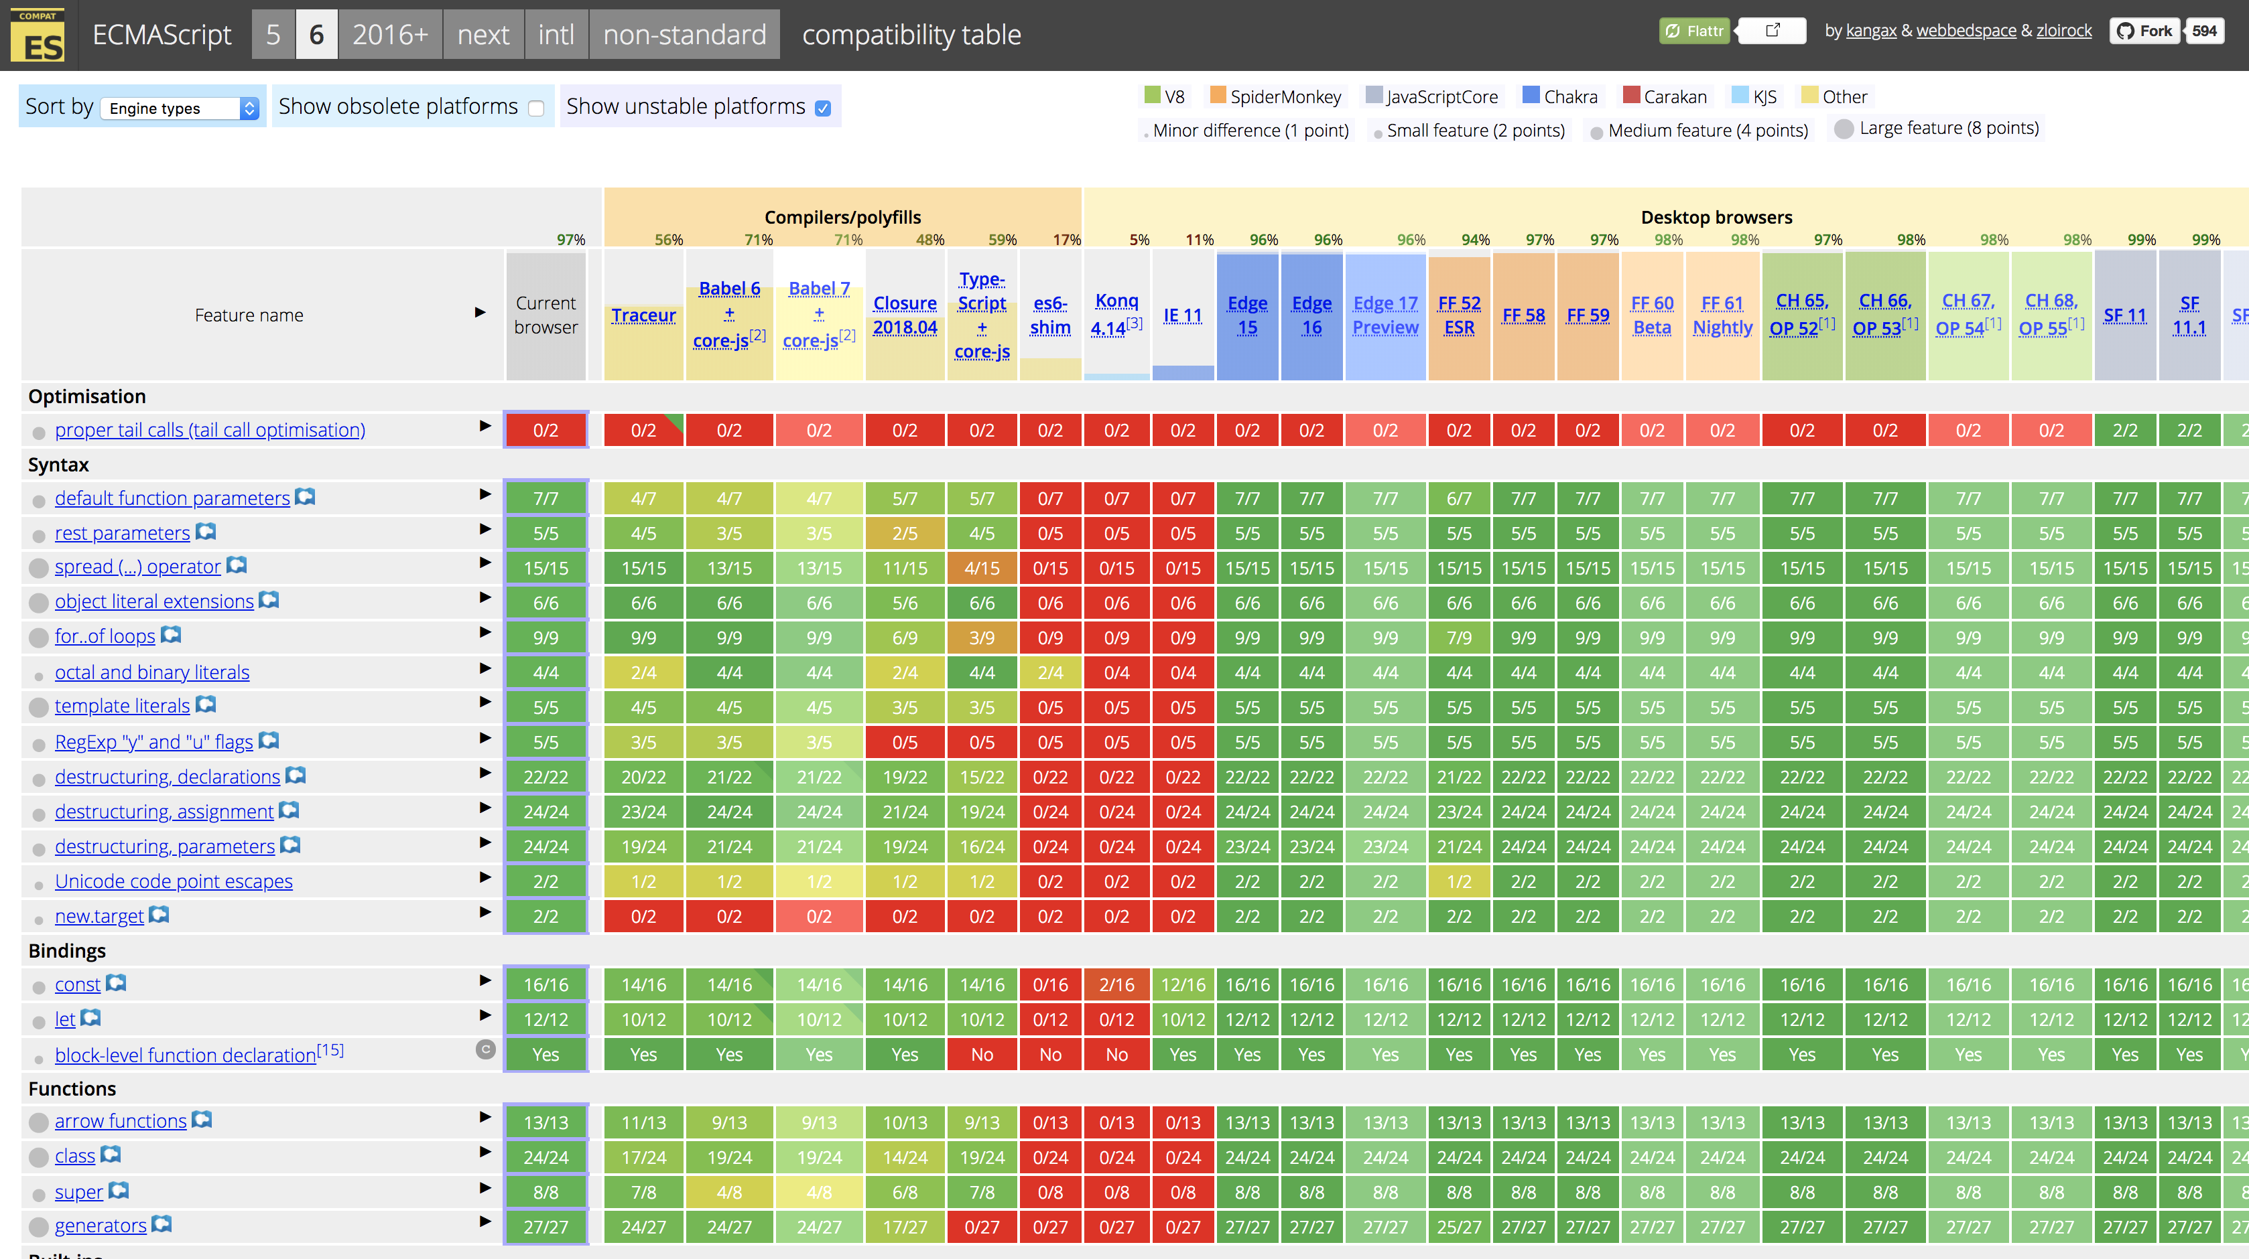
ES6 Support
http://kangax.github.io/compat-table/es6/

Slide 4
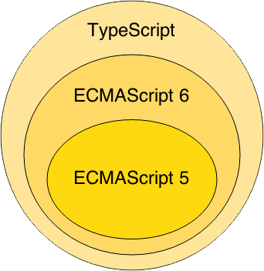
ES6
ES6 superset of ES5
Transpile ES6 to ES5
Notes:
`Wat zijn de voordelen van typescript

Slide 5
Let’s dive into it!
Notes:
https://www.youtube.com/watch?v=WZQc7RUAg18

Slide 6
Variables
No need for “var” anymore

Slide 7
Variables
Block scoped instead of function scoped
const
let
Notes:
Hoisting: is make a variable available everywhere within a function.
const: variable can’t be assigned again vs var
let: variable can be assigned again vs var

Slide 8
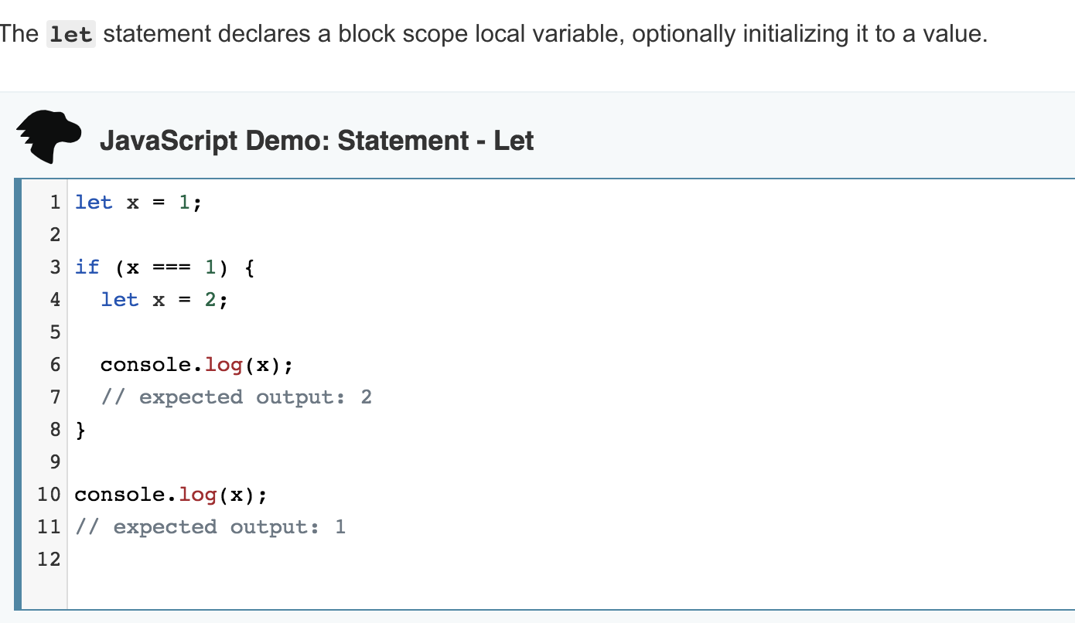
Notes:
https://developer.mozilla.org/en-US/docs/Web/JavaScript/Reference/Statements/let

Slide 9
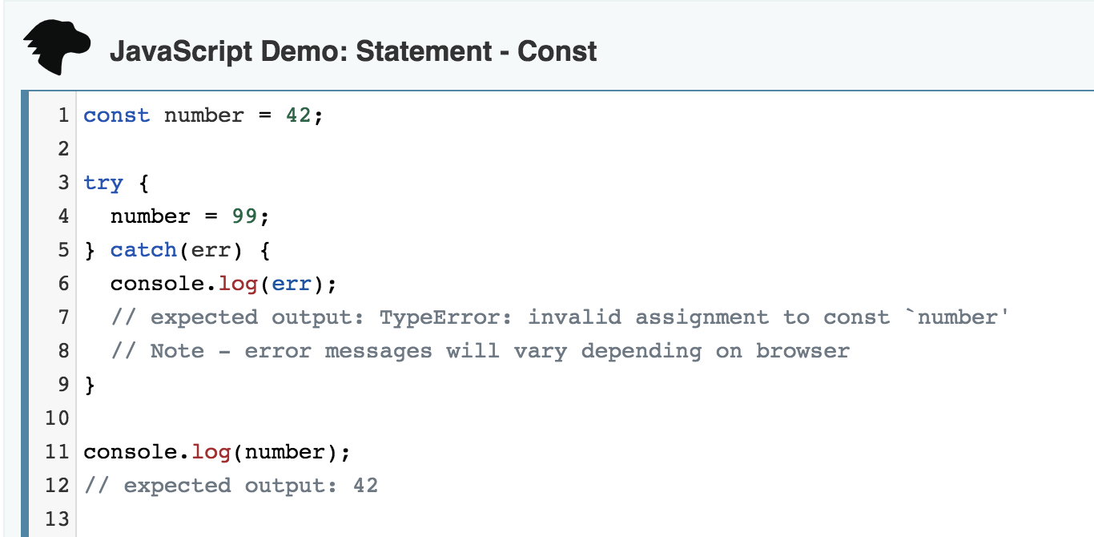

Slide 10
function() {
const x = "x";
x = "something else";
// Uncaught TypeError:
Assignment to constant variable.
const y = {key: 'y'};
y.key = 'x'; // this works
}
Notes:
‘const’ works only one level deep.
Object.freeze
The Object.freeze() method freezes an object: that is, prevents new properties from being added to it; prevents existing properties from being removed; and prevents existing properties, or their enumerability, configurability, or writability, from being changed, it also prevents the prototype from being changed. The method returns the passed object.

Slide 11
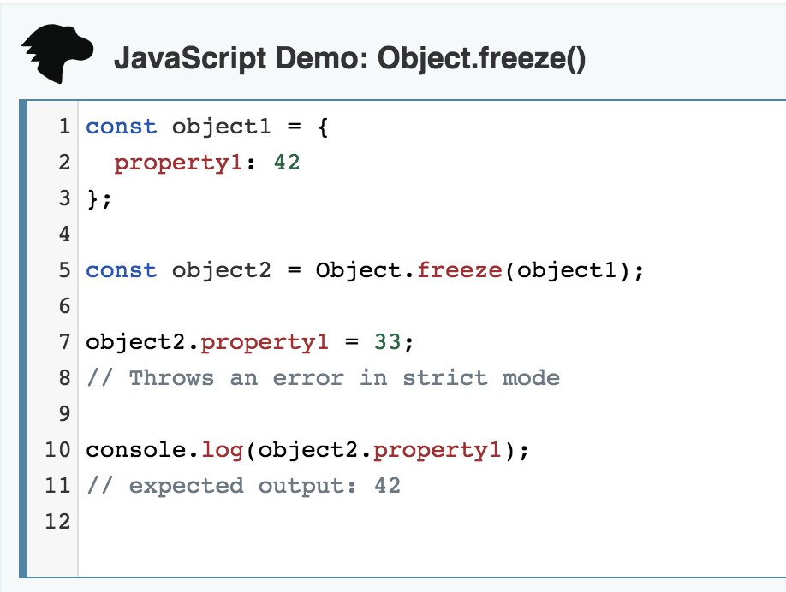
Notes:
Object.freeze
The Object.freeze() method freezes an object: that is, prevents new properties from being added to it; prevents existing properties from being removed; and prevents existing properties, or their enumerability, configurability, or writability, from being changed, it also prevents the prototype from being changed. The method returns the passed object.

Slide 12
Exercise
MDN: Let
MDN: Const

Slide 13
Arrow functions
lambda’s, anonymous inner classes

Slide 14
Arrow functions
// Old Syntax const foo = function foo() { console.log("Hello World..!"); }
// New Syntax
const foo = () => { console.log("Hello World..!"); }

Slide 15
Arrow functions syntax
There are two parts of the syntax.
const newOne = () // assigning function
2. => {} // declaring body of function
Notes:
The first part is just declaring a variable and assigning the function (i.e) () to it. It just says the variable is actually a function.
Then the second part is declaring the body part of the function. The arrow part with the curly braces defines the body part.

Slide 16
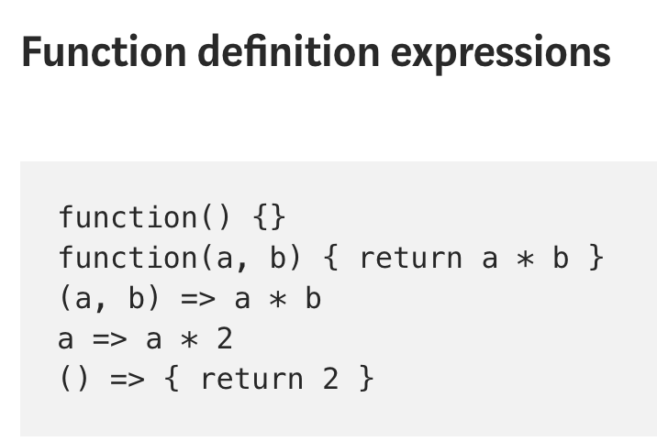

Slide 17
Normal functions
const evens = {2,4,6,8,10}
const odds = evens.map(function (v) { return v + 1; });
const pairs = evens.map(function (v) { return { even: v, odd: v + 1 }; });
const nums = evens.map(function (v, i) { return v + i; });
Odds = 3,5,7..
Pairs = [{2,3}, {4,5}, {6,7}]

Slide 18
Arrow functions
evens = {2,4,6,8,10}
odds = evens.map(v => v + 1)
pairs = evens.map(v => ({ even: v, odd: v + 1 }))
nums = evens.map((v, i) => { return v + i;})
Instead of:
odds = evens.map(function (v) { return v + 1; });
pairs = evens.map(function (v) { return { even: v, odd: v + 1 }; });
nums = evens.map(function (v, i) { return v + i; });

Slide 19
Arrow functions
Work the same as Java 8 lambda’s Except for:
Function is not bound to interface implementation
Arrow head is -> instead of =>

Slide 20
Arrow functions
function Person(){
this.age = 0;
setInterval(() => {
this.age++; // |this| properly refers to the person object
}, 1000);
}
var p = new Person();
Notes:
A new this scope
The this scope with arrow functions is inherited from the context.
With regular functions, this always refers to the nearest function, while with arrow functions this problem is removed, and you won't need to write var that = this ever again.

Slide 21
Exercise
MDN: Arrow functions

Slide 22
Default parameter values
let increment = (test = 2) => test + 1;
increment(3); // 4
increment(); // 3
increment(undefined); // 3
let increment = (test) => test + 1;
Notes:
// or
(test = 1) = means that 1 will be the default value if no parameter.
You could also just make a function:
let bicrement = function(test = 2) { return test + 2;}

Slide 23
Exercise
MDN: Default parm

Slide 24
Rest parameters
function foo (x, y, ...a) {
return (x + y) * a.length
}
foo(1, 2, "hello", true, 7) === 9
Notes:
De rest parameter syntax laat ons toe om een onbepaald aantal argumenten te vertegenwoordigen als een array.
the rest parameter lets you bundle elements back into an array.

Slide 25
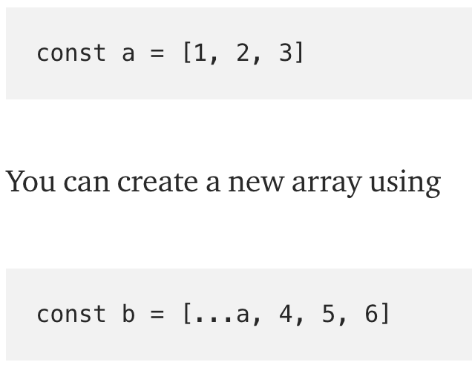
Spread operator
Notes:
The Spread operator allows you to expand an array into its individual elements

Slide 26
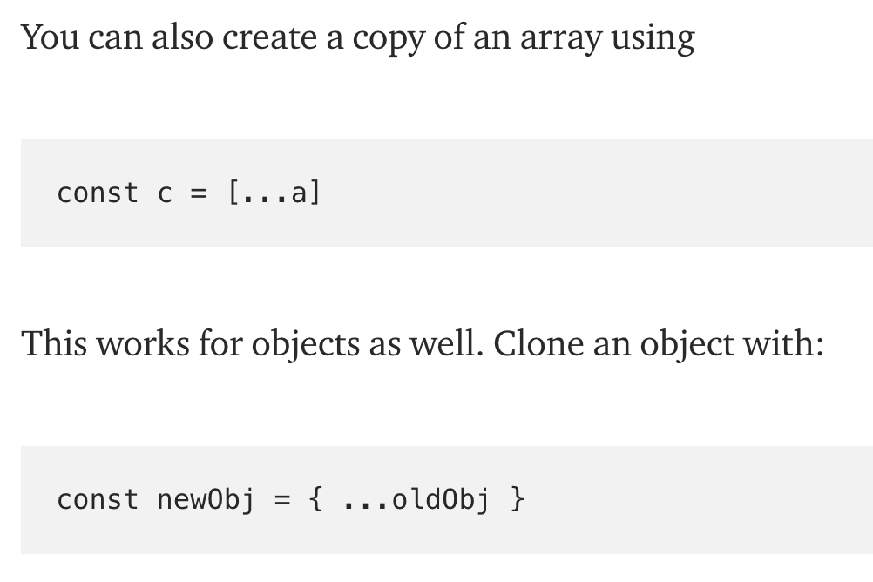

Slide 27
Exercise
MDN: Spread operator
and Rest parm

Slide 28
Template literals
let x = `testing ${1 + 1}` → Backticks!
let y = `hello world ${funcHallo()}`
instead of:
let x = “testing” + (1 + 1)

Slide 29
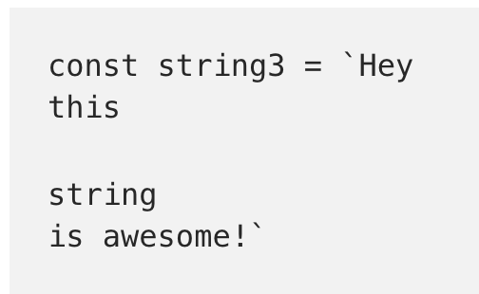
Template literals

Slide 30
Exercise
MDN: Template literals

Slide 31
Enhanced Object properties
const x = 2, y = 3;
let obj = { x, y };
// is equivalent to:
let obj = { x: x, y: y };

Slide 32
Exercise
MDN: Enhanced object properties

Slide 33
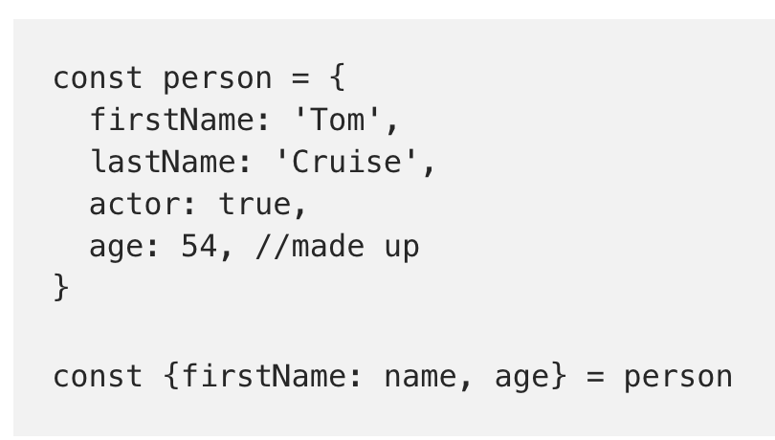
Destructuring Assignment
Notes:
MDN: The destructuring assignment syntax is a JavaScript expression that makes it possible to extract data from arrays or objects into distinct variables.

Slide 34
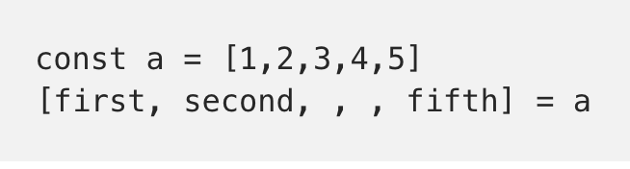
Destructuring Assignment

Slide 35
Exercise
MDN: Destructuring

Slide 36
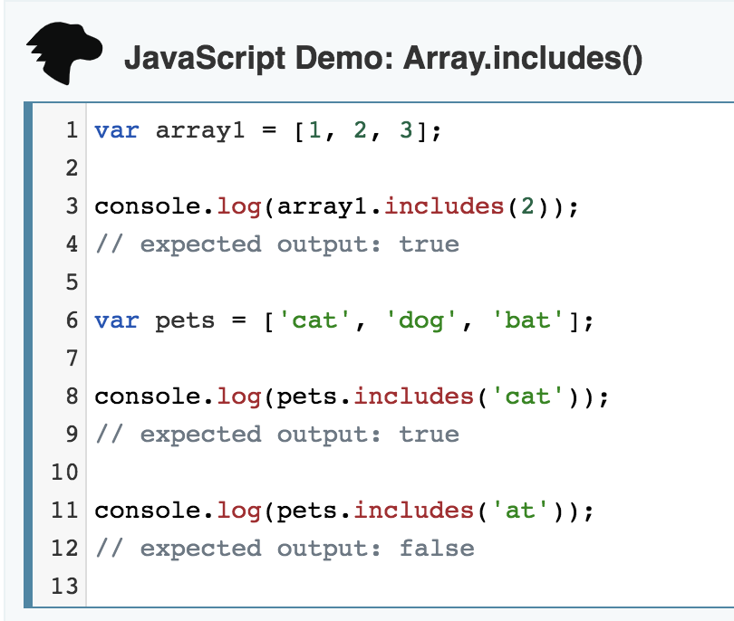
Array.includes()

Slide 37
Exercise
MDN: Array includes

Slide 38
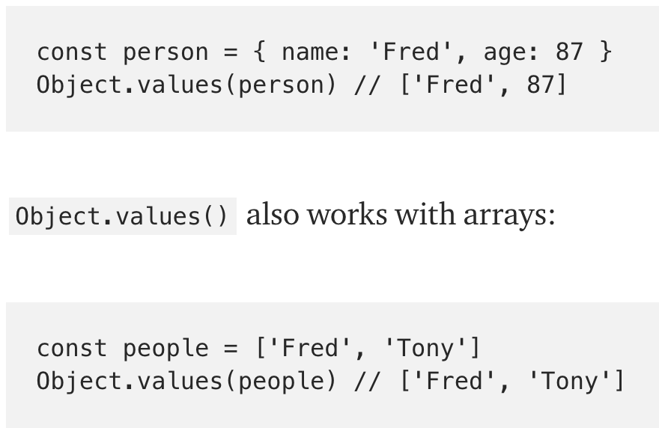
Object.values()

Slide 39
Exercise
MDN: Object values
Object entries

Slide 40
for..in versus for..of Loops
Read: https://bitsofco.de/for-in-vs-for-of/

Slide 41
Classes
class Shape {
constructor (id, x, y) {
this.id = id;
this.x = x;
this.y = y;
}
size () {
return this.x * this.y;
}
}
const square = new Shape('test-id', 3, 3)
square.size();

Slide 42
Classes
class Square extends Shape {
constructor (id, length) {
super(id, length, length);
}
}
new Square('test', 3).size();

Slide 43
Classes
class Square extends Shape {
constructor (id, x) {
super(id, x, x);
}
static calcSize(length) {
return length * length;
}
}
Square.calcSize(3);

Slide 44
Exercise
MDN: Classes

Slide 45
Component
Notes:
A component may be a variable, function, class and so forth

Slide 46
Modules
Notes:
A module is a collection of small independent units (components) that we can reuse in our application.

Slide 47
What’s the purpose?
Encapsulate behaviour
Easy to work with
Easy to maintain
Easy to scale

Slide 48
Modules
//------ module.js ------
export const sqrt = Math.sqrt;
export function square(x) { return x * x; }
export function diag(x, y) { return sqrt(square(x) + square(y)); }
//------ program.js ------
import { square, diag } from ‘module';
console.log(square(11)); // 121
console.log(diag(4, 3)); // 5
Notes:
export compare to public in Java .
http://2ality.com/2014/09/es6-modules-final.html

Slide 49
And what can we actually export?
A variable
An object literal
A class
A function
Notes:
verything that can be exported by the export statement is a component

Slide 50
Map
var newMap = new Map( ); newMap.set('name', 'John'); newMap.set('id', 2345796); newMap.set('interest', ['js', 'ruby', 'python']);
newMap.get('name'); // John newMap.get('id'); // 2345796 newMap.get('interest'); // ['js', 'ruby', 'python']

Slide 51
Set
var set = new Set( ); set.set('name', 'John'); set.set('name', 'Andy'); set.set(1, 'number one'); set.set(NaN, 'No value');
set.get('name'); // Andy. Note John is replaced by Andy. set.get(1); // number one set.get(NaN); // No value

Slide 52
Exercise
MDN: Map
MDN: Set

Slide 54
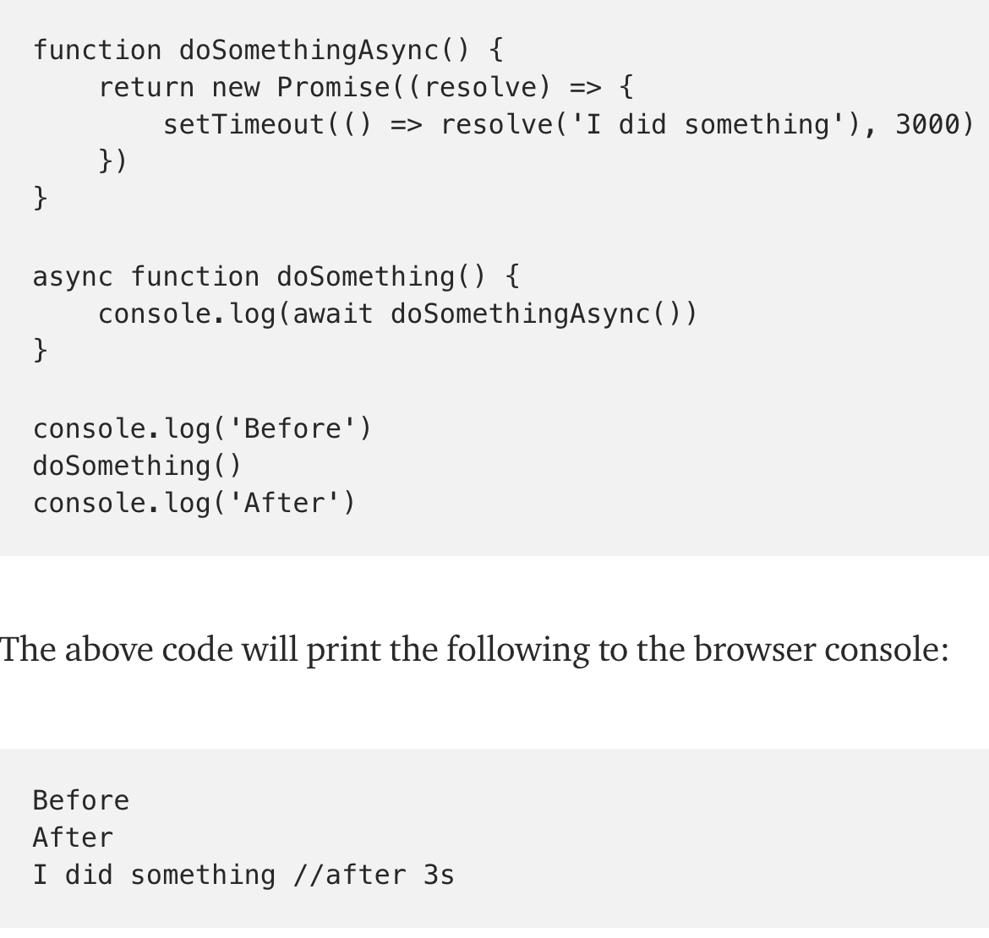
async/await

Slide 55
Exercise
MDN: Async await

Slide 56
Exercise
http://es6katas.org/

Slide 57
And many many more things
Symbols, generators, Weak Link datasets
A lot of extensions on built-ins
Learn more about this, scan this page: http://es6-features.org/

